Slide 1

Fractal Factory
Code is Art
Kenny Mejia, Candice Rivera, Jada Tijani, Brandon Kline, and Eric Stenton
Notes:
Kenny

Slide 2
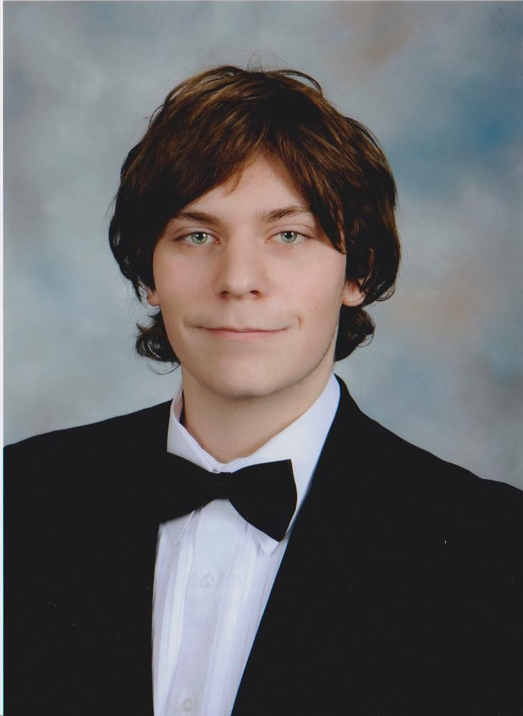



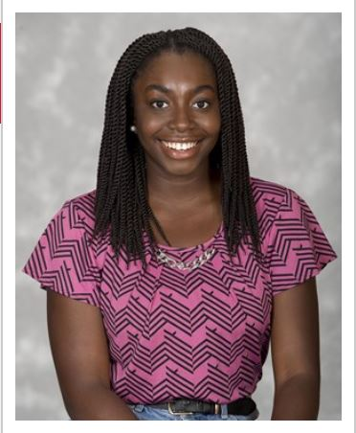
Team Pictures
Brandon Kline (IT)
Candice Rivera (CS)
Eric Stenton (CS)
Kenny Mejia (CS)
Jada Tijani (IS)
Notes:
All → Introductions

Slide 3
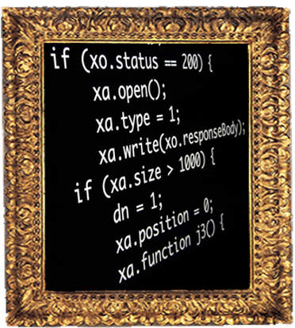
Is Coding An Art ?
Indentation
Spacing & use of whitespace
Comments & documentation
Line length
Notes:
Kenny is coding an art? we follow guidelines indentation, spacing, comments, documentation, line length we follow everything our professors our mentors tell us to do In order to do what? to create objects of beauty (next slide)

Slide 4
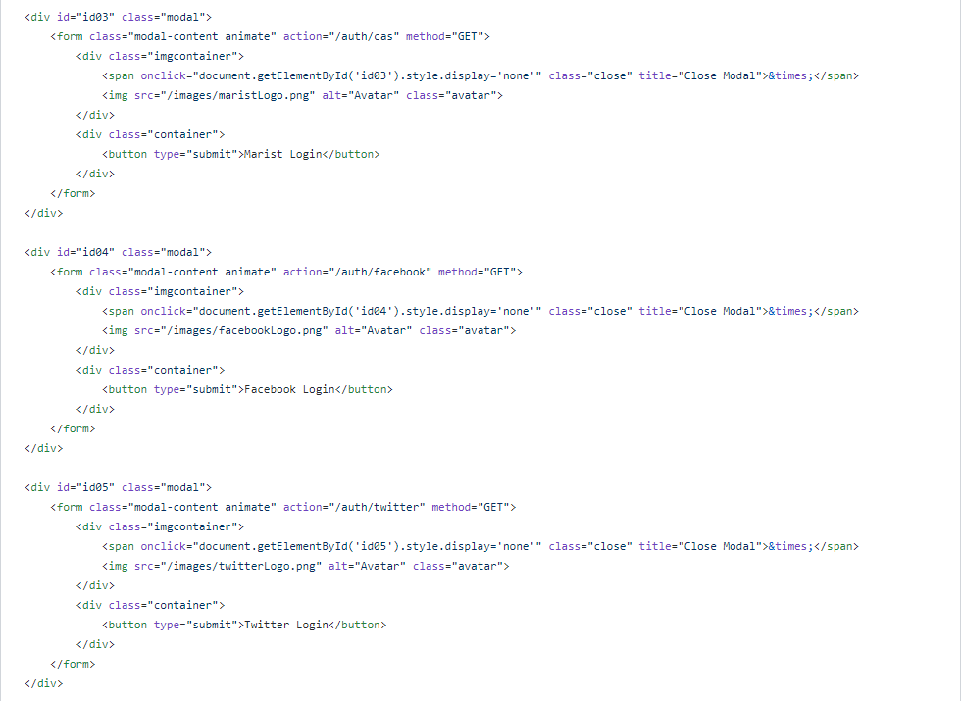
Notes:
Kenny (Visual aid for previous slide)
if proper guidelines are followed we create lines of text that begin to form patterns coding is an art form
it applies accumulated knowledge to the world, because it requires skill and ingenuity, and especially because it produces objects of beauty

Slide 5

Promotional Video
Link if above doesn’t work
Notes:
Candice

Slide 6

Requirements
Create a service that allows users to upload programming code
Analyze the code and produce an artistic image that represents it
Allow users to select a painting that will affect their artistic image
Notes:
Candice

Slide 7
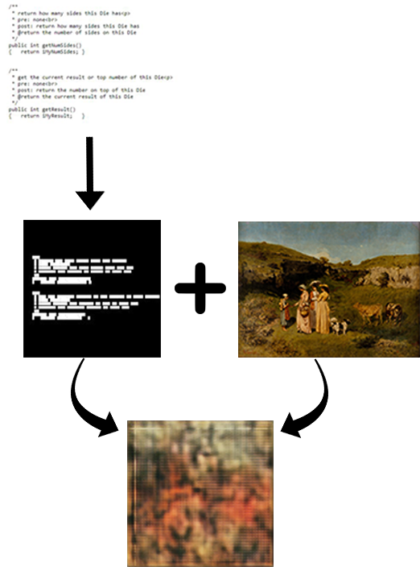
Process
User Code
BAM Image
Painting
New Art
Notes:
Eric
-User submits code
-code converted to BAM
-BAM and painting serve as inputs to a neural network
-Neural network generates a new artwork
-Block Artifact Map
-Fractal dimensions

Slide 8
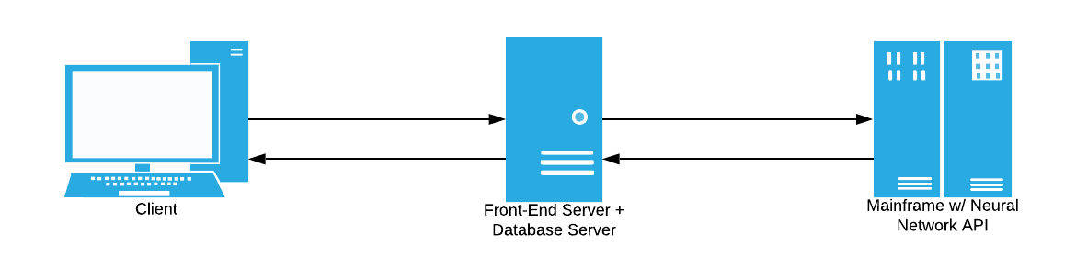
Infrastructure
Notes:
Brandon

Slide 9
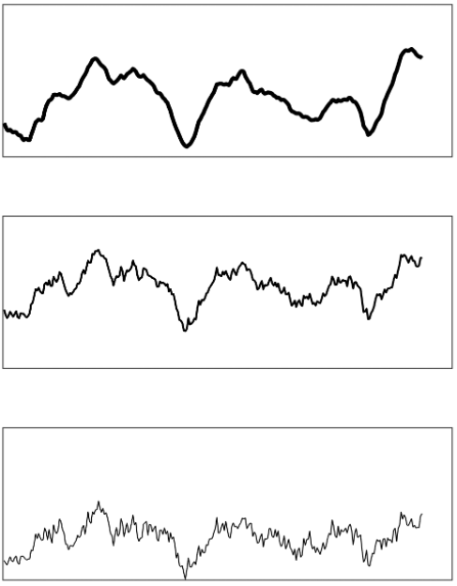
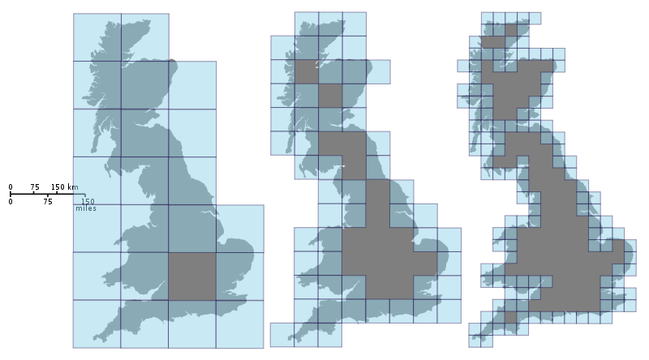
Fractal Dimension
“In mathematics, Hausdorff dimension (a.k.a. fractal dimension) is a measure of roughness and/or chaos that was first introduced in 1918 by mathematician Felix Hausdorff”
Quote Source: Gneiting, Tilmann; Ševčíková, Hana; Percival, Donald B. (2012). "Estimators of Fractal Dimension: Assessing the Roughness of Time Series and Spatial Data". Statistical Science. 27 (2): 247–277. arXiv:1101.1444. doi:10.1214/11-STS370
Notes:
Eric
-A fractal dimension, in simplest terms, is a value that denotes how edgy or complex a shape or line is
-The image on the right shows three lines that increase in complexity. If we were to measure the fractal dimensions of these lines, we would find the top, smoother line would have a smaller fractal dimension than the bottom, edgier line.
-Box counting → Recursion

Slide 10

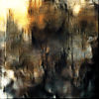
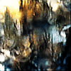
Neural Network
BAM latent space
Painting latent space at different stages
Paintings during training
Notes:
Eric
-Top three are gifs -- just a bit slow
-Generative variational autoencoder neural network
-Encode and decode process
-Trained on BAM and painting images
-Training = combining BAM with painting and fractal dimensions….then recreate the original images → will try to improve the accuracy of the recreated image

Slide 11
Demo
Notes:
Eric

Slide 12

Notes:
Eric → Backup demo

Slide 13
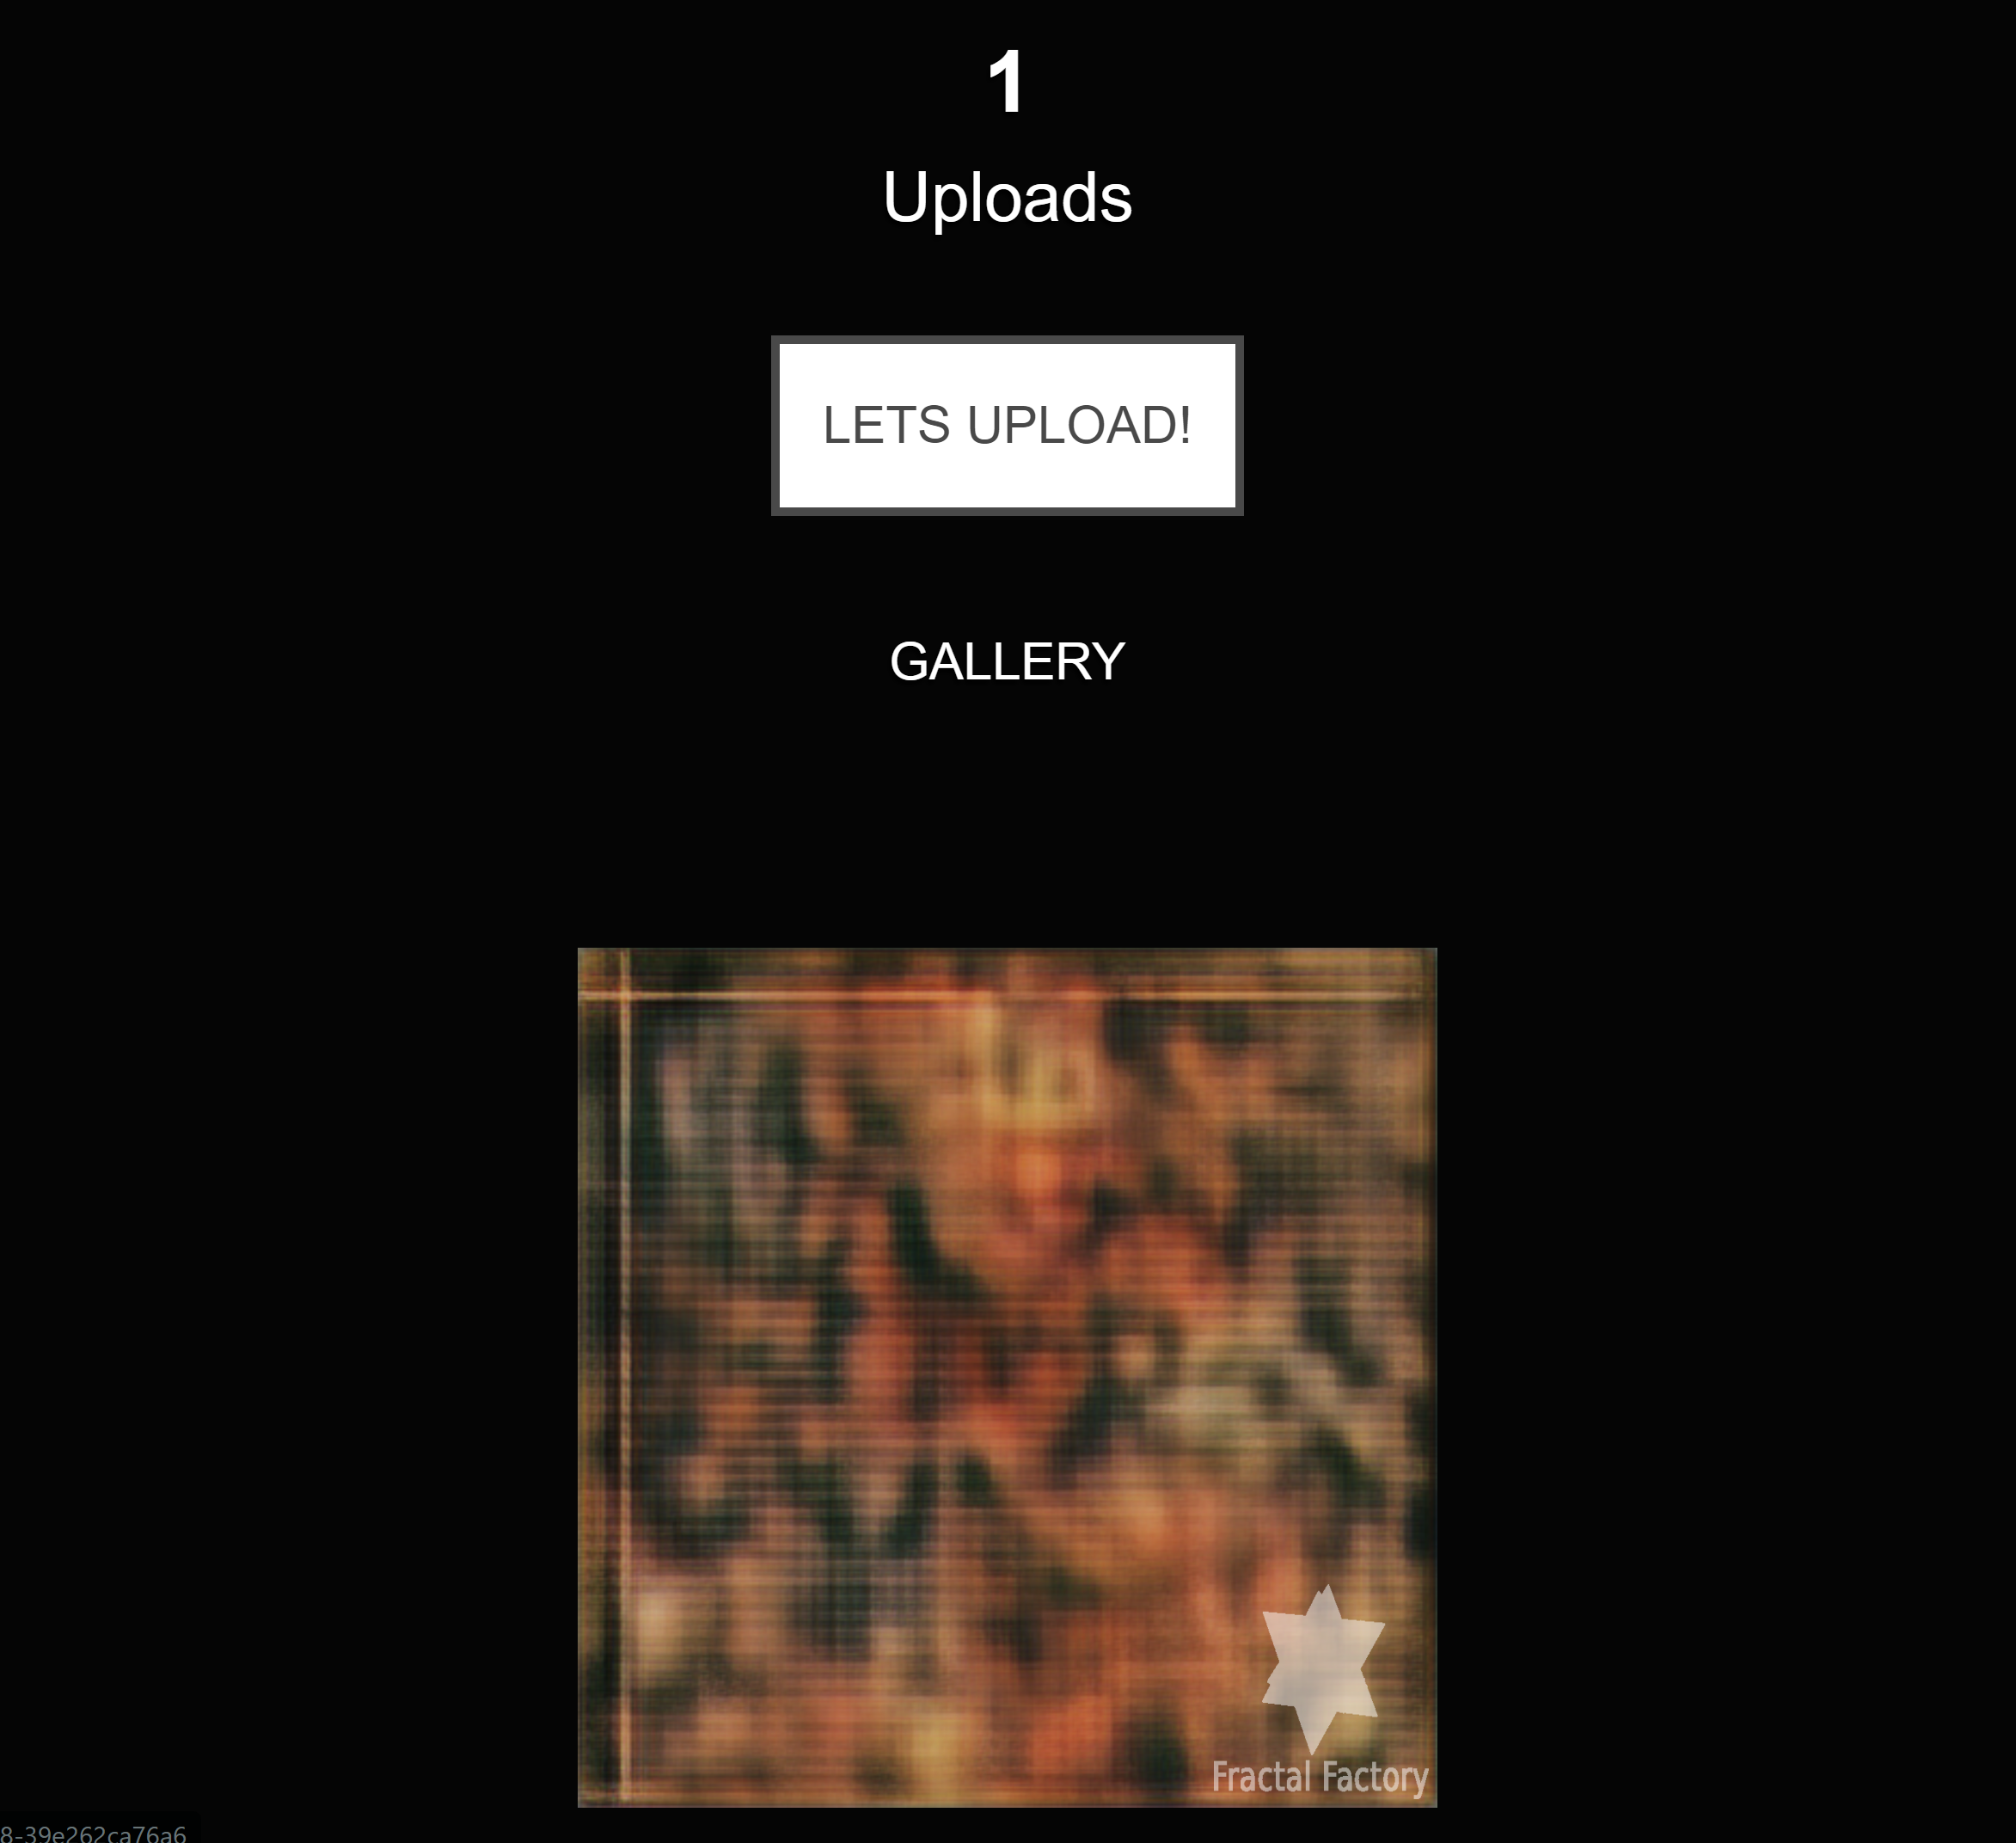
Notes:
Eric → Backup demo

Slide 14
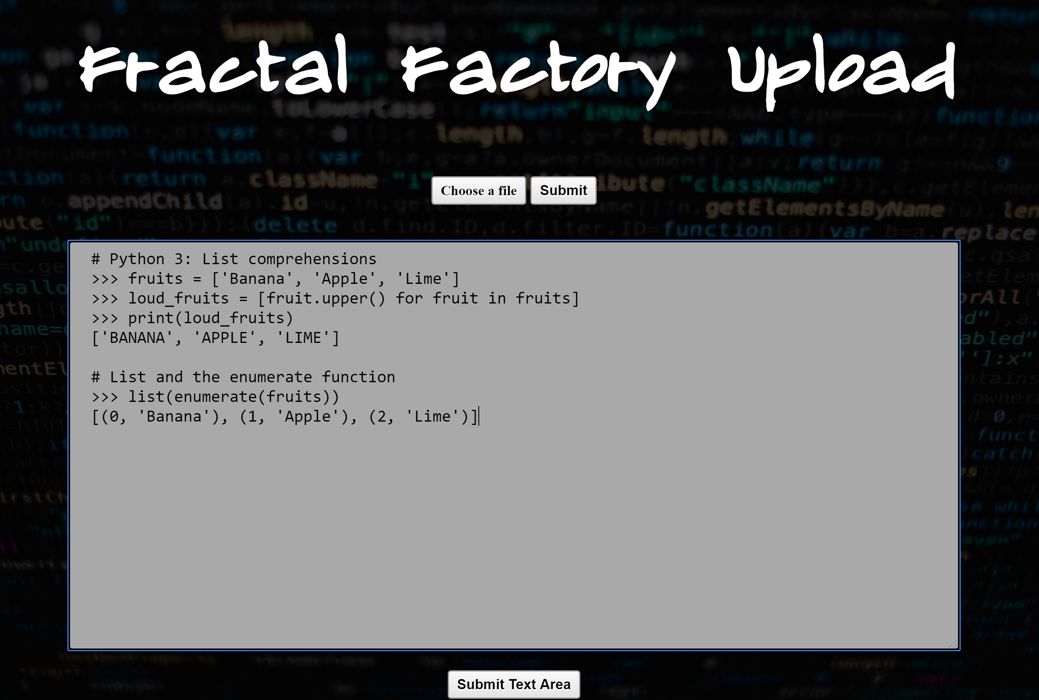
Notes:
Eric → Backup demo

Slide 15
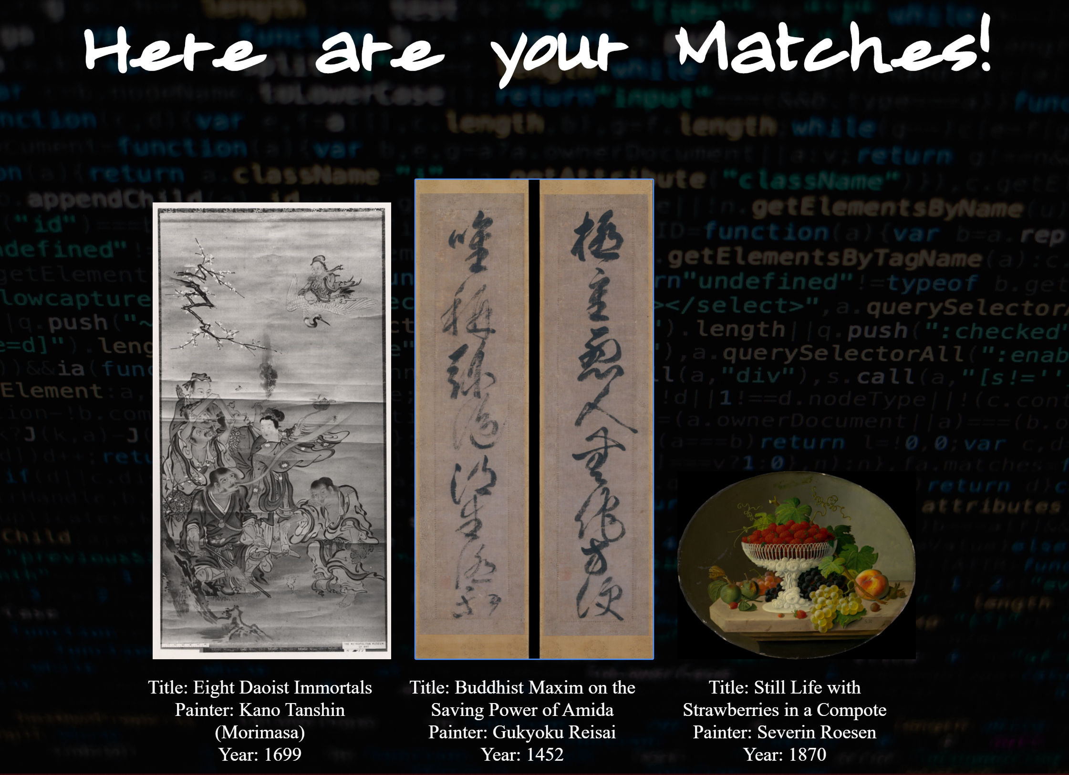
Notes:
Eric → Backup demo

Slide 16
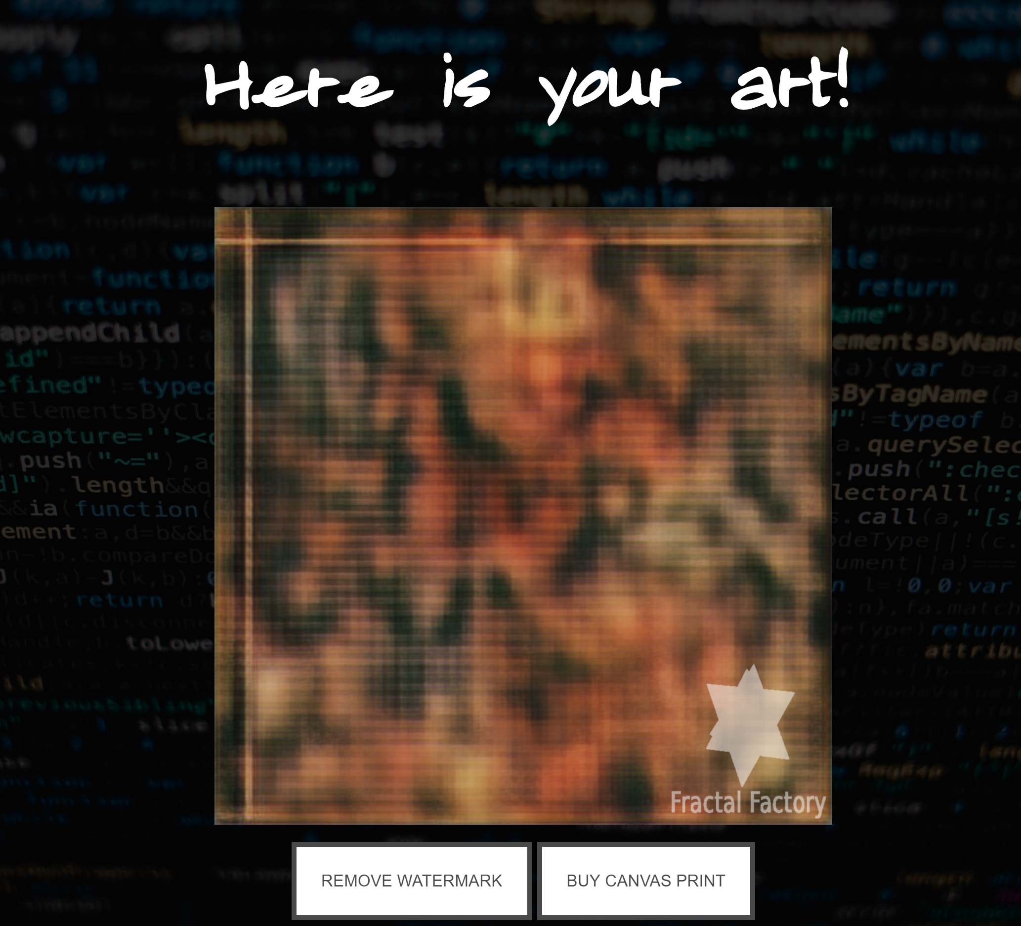
Notes:
Eric → Backup demo

Slide 17

The Future
Notes:
Jada

Slide 18
Thank You!
Any Questions?
Jada (IS)
Brandon (IT)
Candice (CS)
Eric (CS)
Kenny (CS)
Notes:
Jada

